Slide 1
Ethical & Professional Responsibility
Derek Brandt - Israel Sanchez Tellez
Tyler Orman - Aryan Rao
Team ID: sddec24-03
Client: DigiClips
Faculty Advisor: Dr. Ashfaq Khokhar

Slide 2
Agenda
Project Overview
Performing Well - Communication Honesty
Not Performing Well - Property Ownership
Potential Ethical Issues
Questions

Slide 3
Project Overview
DigiClips is a company whose goals are to…
Record media from multiple sources
Process the media that has been recorded
Image to text processing
Closed captions
Video truncation
In order to do this they use multiple machines and a client server to share the data.

Slide 4
Project Overview
We aid Digiclips by providing an administrative portal that…
Monitors each machine they use to record
Can modify config files on those machines
Display machine statistics
Manage the client’s accounts

Slide 5
Performing Well -
Communication Honesty

Slide 6
Communication Honesty
Since we are providing a software we need to…
Maintain code documentation
Clear reasoning for implementation choices
Provides future developers with resources
Demonstrate designs to DigiClips
Provide reasoning
Get design approval
Pick one IDEALS professional responsibility area (see Slide 9) in which your team is performing well and discuss…
Its relevance to your project
Your team’s approach in this area
Why your team’s approach upholds ethical and professional responsibilities

Slide 7
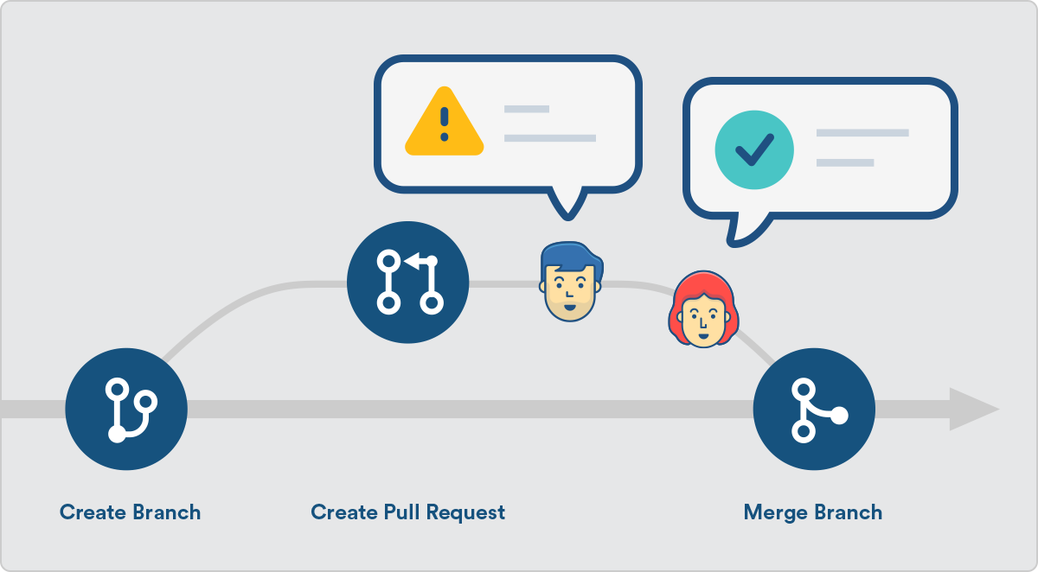
Communication Honesty
In order to communicate honestly we will…
Use GitHub pull requests
Provides an open record to DigiClips
Ensures no one person has total control
Maintain a ReadMe
Everyone in DigiClips can run the software
Weekly meetings with DigiClips
Presenting all work done within the week
Meeting notes to maintain public record

Slide 8
Needs Improvement -
Property Ownership

Slide 9
Property Ownership
The administration portal will have access to…
Client emails
Client first and last names
Server names and locations
These are all things that need to be protected.
Our current implementation has the following characteristics…
Open to all who have access to the portal
Openly displays server information

Slide 10
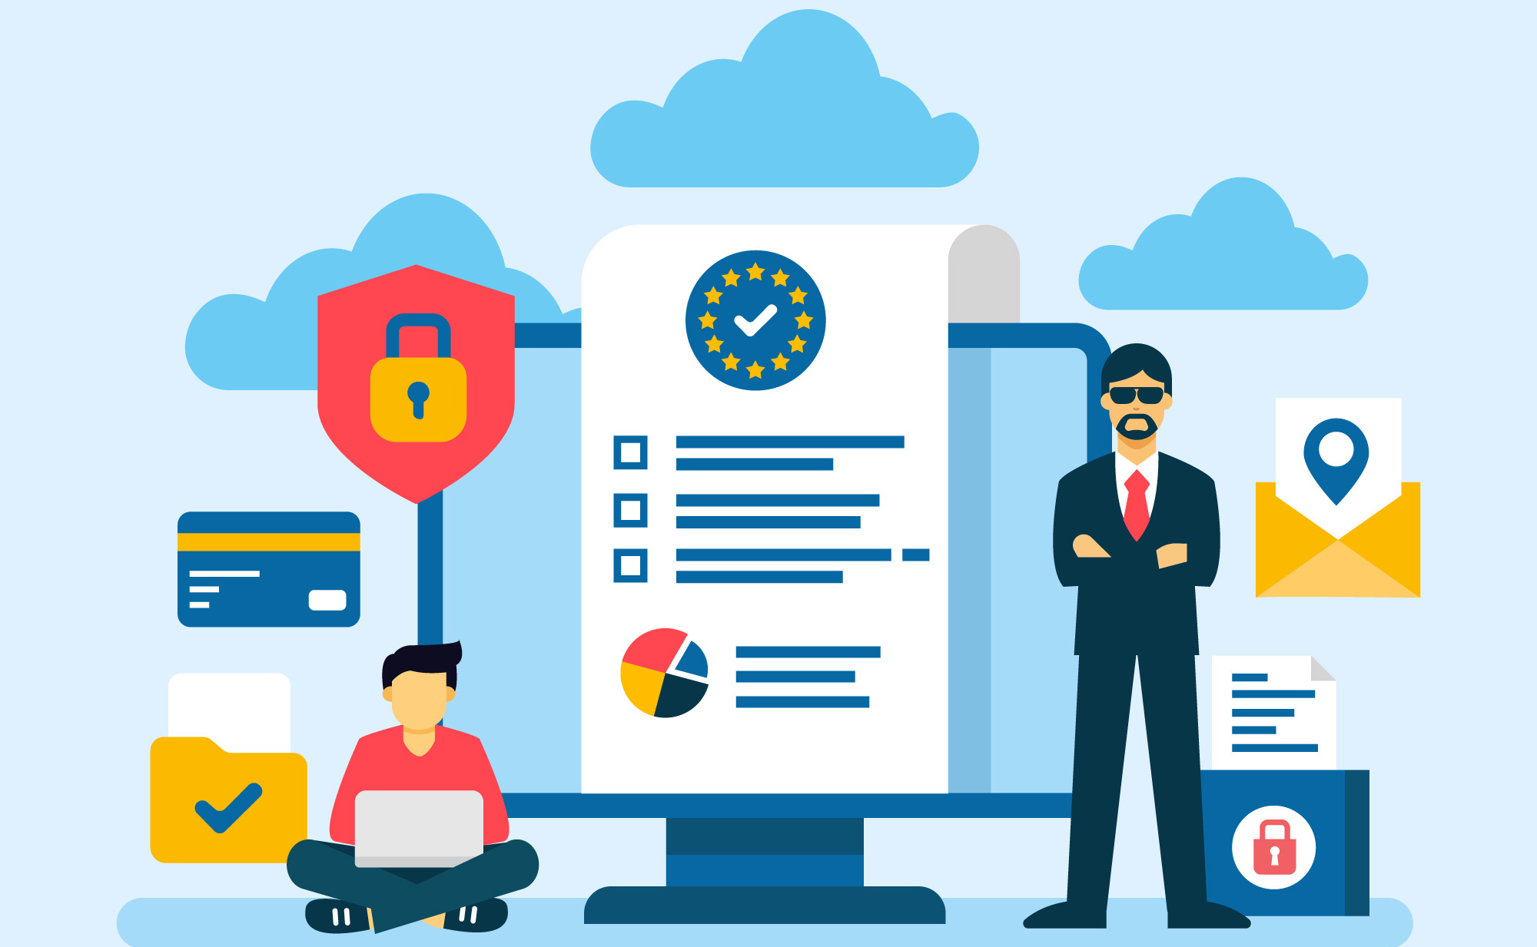
Property Ownership
Our future implementation will protect our client’s information by…
Creating settings to restrict who can see client information
Ensuring that encryption takes place between the database and our admin portal
We will protect DigiClips information by…
Creating permission locks
Using the database as a safety net

Slide 11
Potential Ethical Issues

Slide 12
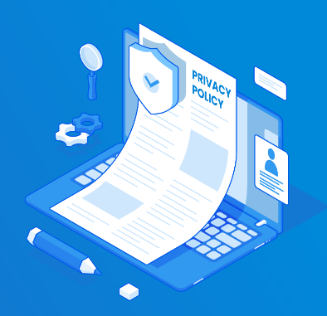
Potential Ethical Issues - Collected User Data
How is DigiClips going to handle user data?
DigiClips should implement a privacy policy.
Enforce a data retention policy as well.
California Privacy Rights Act
European GDPR

Slide 13
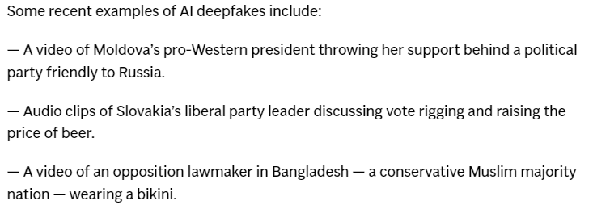
Potential Ethical Issues - Misinformation
(Swenson and Chan Election disinformation takes a big leap with AI being used to deceive worldwide)

Slide 14
Questions?

Slide 15
Reference
Swenson, Ali, and Kelvin Chan. “Election Disinformation Takes a Big Leap with AI Being Used to Deceive Worldwide.” AP News, AP News, 14 Mar. 2024, apnews.com/article/artificial-intelligence-elections-disinformation-chatgpt-bc283e7426402f0b4baa7df280a4c3fd.

